Slide 1


Real-Time Rendering
Carl Jones
Particle Systems

Slide 2
Particle System Structure
Data type | Name |  | Description
Texture | *texture | A pointer to a texture, which all particles will use. For performance reasons, we only use one texture for each individual particle system; all particles within the specific system will have the same texture assigned.
Array Particle | particles | The collection of particles within this system. This may also be a linked list instead of an array.
int | nrAlive | Number of particles in the system which are still alive. If this value is zero, it means all particles are dead and the system can be removed.

Slide 3
Parametric Particle Systems
Parametric or stateless particle systems - each particle position is described parametrically
The position of the particle can be determined procedurally
Advantages:
  Requires no particle state
  No integration of motion is required
Disadvantages:
  The motion of a particle if fixed and predictable

Slide 4
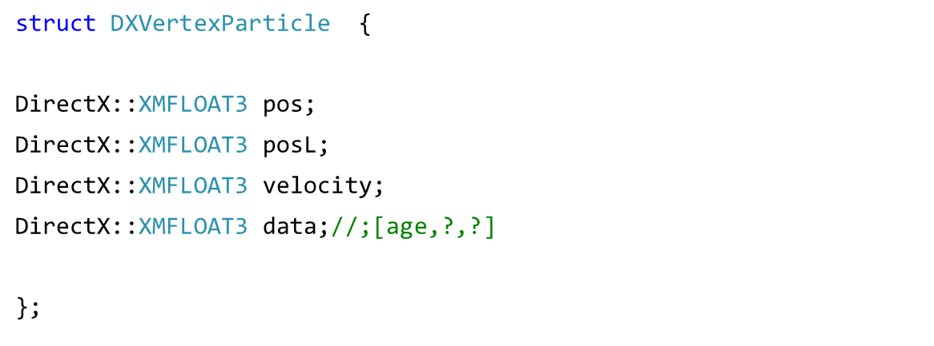
Parametric Particle Structure

Slide 5
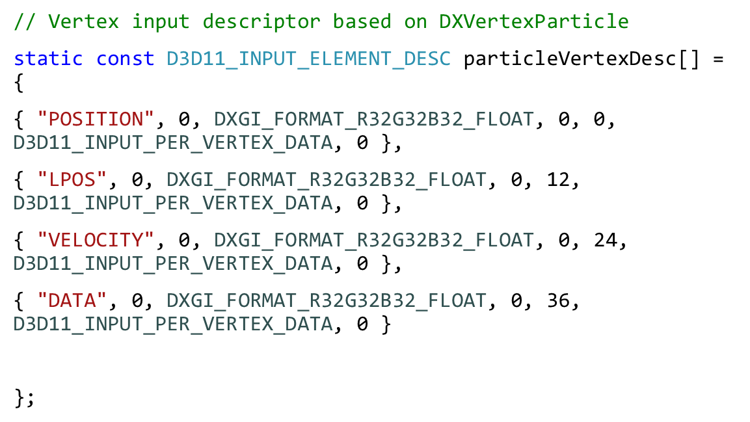
Particle vertex input description – Simple Parametric

Slide 6
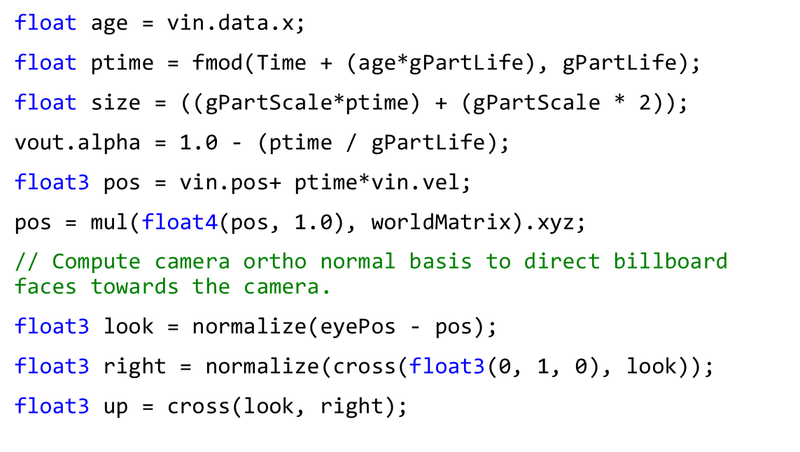
Vertex Shader – Simple Parametric

Slide 7
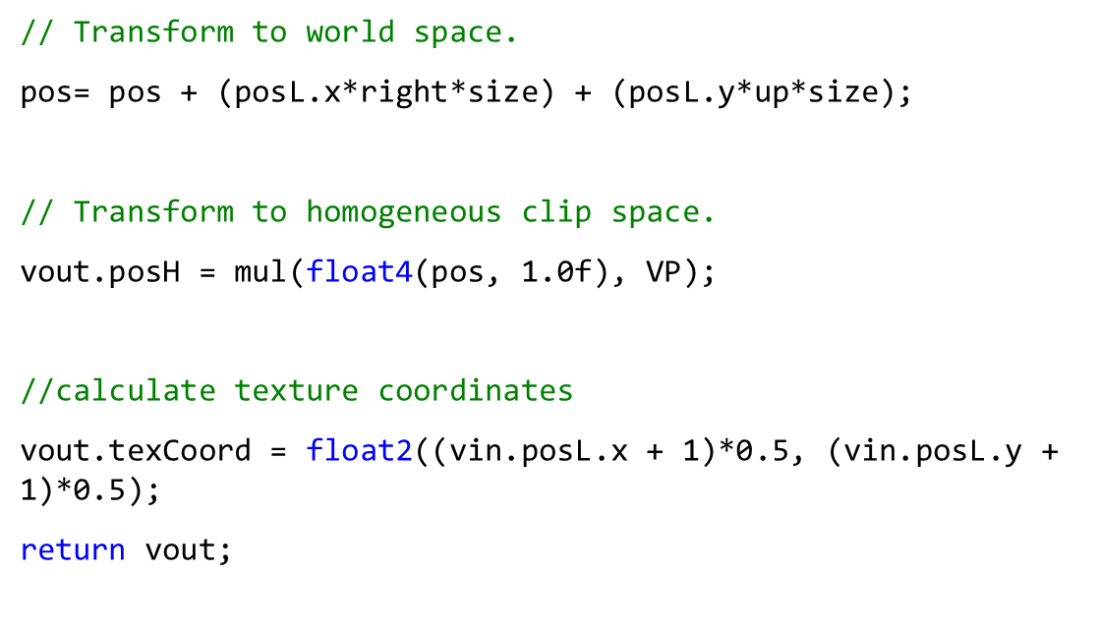
Vertex Shader cont...

Slide 8
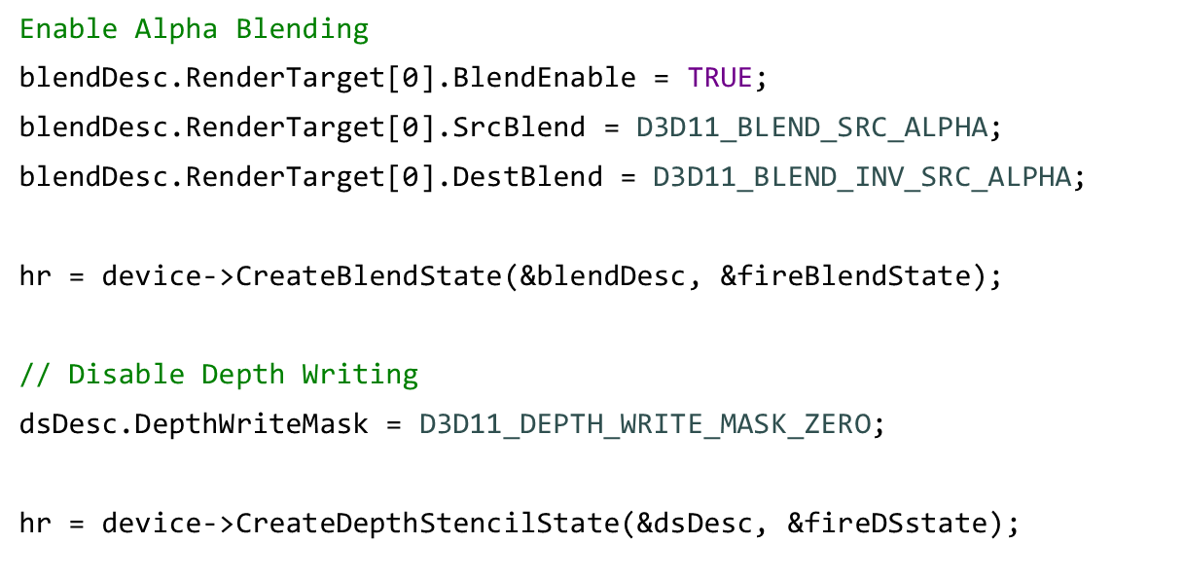
Blending and Depth Buffer Setup

Slide 9
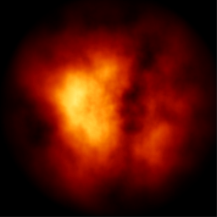
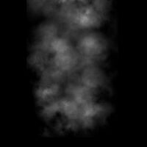
Particle Textures

Slide 10
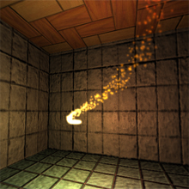
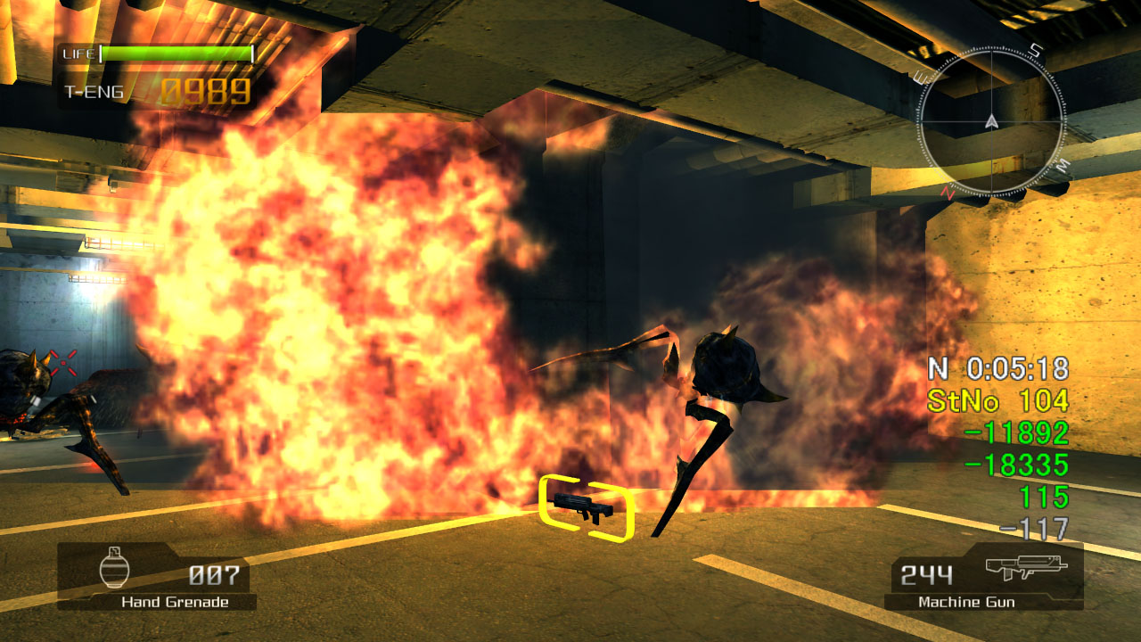
Sparks, Fire, Smoke etc…

Slide 11
Iterative Particle System
Data type | Name | Description
Vector3 | position | The position of the particle in world-space
Vector3 | oldPos | The previous position of the particle, useful in some systems
Vector3 | velocity | The velocity vector (position += velocity)
dword | color | The color of the particle (its vertex colors)
int | energy | The energy of the particle
float | size | The size of the particle

Slide 12
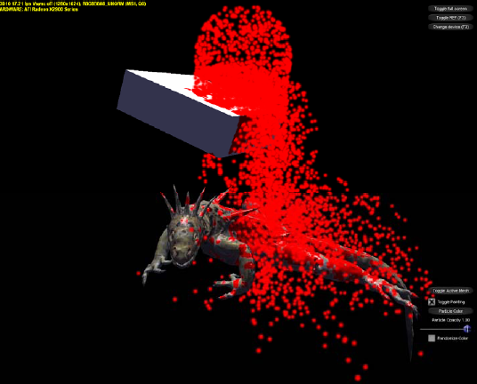
Iterative Particle System Update
P=P +(V*t)
Add gravity or wind
Kill particle
More advanced Systems can perform collision detection for each particle

Slide 13
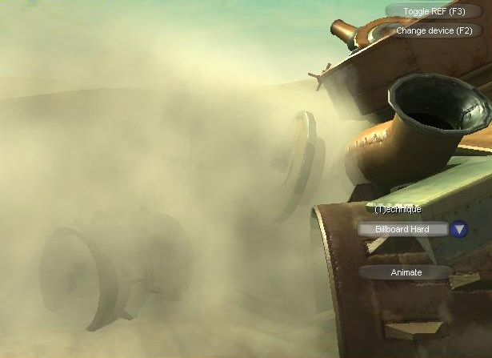
Soft Particles

Slide 14
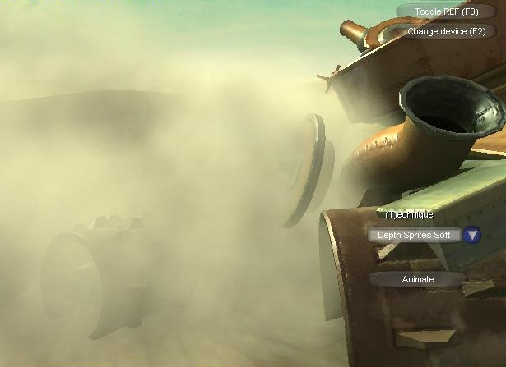
Soft Particles
Perturb the alpha being output from the pixel shader by a depth stored in the particle texture.
Alpha = saturate((Zscene – Zparticle) * scale)

Slide 15
GPU
Manage millions of particles
Store particle XYZ position in RGB Texture
Store Particle XYZ velocity in RGB Texture
Sample textures and update particle positions in shader
Alternatively use StreamOut (shader model 4 DX10)
Advantages
Fast no communication with CPU
Disadvantages
Consume GPU time

Slide 16
FURTHER READING
Advanced Particle Systems
http://www.gamasutra.com/features/20000623/vanderburg_01.htm
Soft Particles
http://developer.download.nvidia.com/SDK/10/direct3d/Source/SoftParticles/doc/SoftParticles_hi.pdf
GPU Particles
http://www.gamasutra.com/features/20040728/latta_01.shtml
Dynamic Particle Systems
Particle System on GPU.pptx
MegaParticlesPaper.pdf

